Slide 1
SPE 164062
Laboratory Studies for Surfactant Flood in
Low-Temperature, Low-Salinity
Fractured Carbonate Reservoir
Aparna Raju Sagi, Maura Puerto, Yu Bian,
Clarence A. Miller, and George J. Hirasaki, Rice University;
Mehdi Salehi, and Charles P. Thomas, TIORCO;
Jonathan T. Kwan, Kinder Morgan.

Slide 2
Introduction

Slide 3
Surfactant EOR :carbonate reservoirs
Carbonate reservoir are usually
  Fractured
  Oil – mixed wet rock
Effectiveness of forced displacement methods
  Injected fluids bypass oil-rich matrix
  40 – 50% OOIP not produced
Surfactants for fractured carbonate reservoirs
  Recover oil from matrix
    Interfacial tension (IFT) reduction
    Wettability alteration to water wet
  Improve fluid distribution in fracture network
    Foam mobility control
Notes:
A good percentage of carbonate reservoirs are fractured – meaning you have a high permeability fractures separating rock matrix blocks of relatively lower permeability.
And a good percentage of carbonate reservoirs are oil wet – meaning if you take a rock containing oil and place it in brine, the brine will not spontaneously displace the oil from the rock.
What does this mean to oil recovery by forced displacement methods like water floods ?
Most of the injected fluid will flow through the high permeability fractures, bypassing the oil that is trapped in your low permeability matrix by capillary forces
How can surfactants help improve oil recovery in such a situation
Reduce IFT – in which case you reduce the capillary force that is holding back the oil and allow the oil to move up by bouyancy
Change wettability to water wet conditions – in which case the wetting phase water will imbibe into the matrix displacing the oil
and surfactants that are good foamers can improve distribution of injected fluids in the fraxture network.

Slide 4
Surfactant flood: Desirable characteristics
Reduce IFT (order of 10⁻² mN/m)
Alter wettability to water wet
Good mobility control
Solubility in injection and reservoir brine
Tolerance to divalent ions
Low adsorption on reservoir rock (chemical cost)
Avoid generation of viscous phases
Surfactant-oil-brine phase behavior stay in Type I regime
Easy separation of oil from produced emulsions
Notes:
So what are we looking for when we choose a surfactant for a surfactant flood.
IFT reduction, wettability alteration and mobility control like I mentioned in my previous slide
You want your surfactant to be soluble in both injection and reservoir brine, and have tolerance to divalent ions.
Low adsorption of the surfactant on the rock as that will decide the amount of surfactant to be injected and the inturn the cost.
Avoid generation of viscous phases
You want your surfactant brine oil phase behavior to be underoptimum (Type ! Regime) – I will get to that in a while
Easy separation of your produced emulsions
In this work we did not address wettability alteration, mobility control and separation of emulsions.

Slide 5
System
Salinity
  ~11,000ppm TDS (low salinity)
  ~1,700ppm TH (Total Hardness)
Temperature ~25°C
Crude oil
  28.2°API
  22.5cP @ 25°C
Pressure
  Atmospheric (dead oil)
  Upto 600psi (live oil)
Notes:
The type of surfactant to be used to achieve what we want depends on the reservoir conditions. The conditions for which we were designing a surfactant flood are as follows
Salinity of ~11,000ppm TDS with ~1,700 ppm of Total Hardness
Temperature of ~ 25C
West texas Crude oil
Pressure was ambient pressure except for the live oil experiments which were carried out upto 600psi

Slide 6
Surfactant selection: phase behavior
Notes:
In this section I will discuss surfactant selection by phase behavior experiemnts

Slide 7
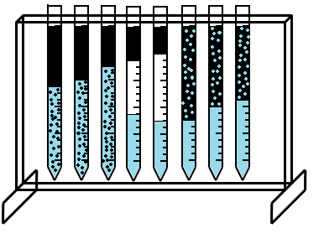
Surfactant optimal salinity
Seal open end
Increasing salinity
Oil
24 hr
micro
Initial interface
micro
Brine + surfactant
(bottom sealed)
Type-I
Type-III
Type-II
Optimal salinity
Optimal salinity for our system (non-classical phase behavior)
  Transition from Type I to Type II
  Maximum oil solubilization parameter
Solubilization parameter
σ_{o}=V_{o}/V_{s}
σ_{w}=V_{w}/V_{s}
Huh’s correlation
IFT∝ 1/σ²
Notes:
To determine the surfactant phase behavior, brine surfactant and oil were taken in a sealed bottom pipette; after which the open end is sealed. The -sample is mixed for 24hrs and then allowed to separate under the action of gravity.
The resultant phases expected based on classical winsor type phase behavior
An o/w microemulsion with excess oil at low salinities labeled here as Type 1
A w/o microemulsion with excess brine at high salinities called Type 2
A bicontinuous microemulsion of oil and water in eq with excess oil and brine phases at intermediate salinities.
Based on the change in level of the o/w interface and assuming that the surfactant is all in the microemulsion phase, we can calculate somehting called the solubilization parameter which is the vol of oil to vol of surf or vol of water to the vol of surfactant in the aq phase.
Solubilization parameter of oil and water increases towards the Type 3 region and this is where ultra low IFTs are achieved. This salinity or range of salinity is called optimal salinity.
Solubilization parameter is a good indicator of IFT as shown by Huh’s correlation IFT is inversely proportional to square of the solubilization parameter.
In our work we used this solubilization parameter as an indicator of low IFT.
For most of the phase behavior experiments with crude oil we did not observe a classical winsor Type phase behavior as described here, instead we saw transition from Type 1 to Type 2 micoremulsion without going through the Type 3 region. In such cases the optimal salinity is determined to be the salinity right before this transition occurs or where the oil solubilization parameter is highest.

Slide 8
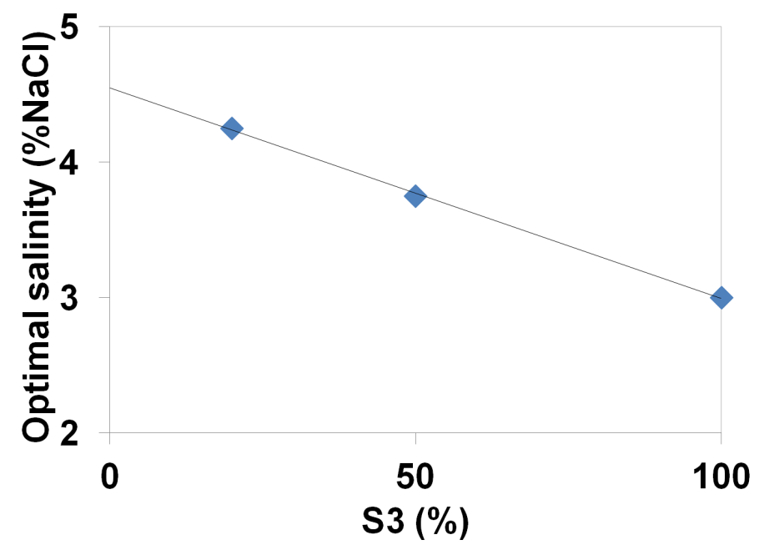
Surfactant selection
Starting point
  Liu et al. (2008) NI blend:
    80/20 C₁₆₋₁₇ 7PO sulfate (S1) IOS₁₅₋₁₈ (S2)
  Good divalent tolerance and IFT reduction
  Optimal salinity with crude ~ 5%NaCl + 1% Na₂CO₃ (too high)
  Replace IOS₁₅₋₁₈ with IOS₂₀₋₂₄ (S3)
    Reduced optimal salinity but not close to desired salinity
1wt%
2wt%
2wt%
C₁₆₋₁₈ 7PO S
IOS₂₀₋₂₄
Notes:
Liu et al. for a similar west texas crude oil used 80/20 blend of a c16-17 7po sulfate and ios 15-18 and had shown
Low ift and good divalent ion tolerance.
So this was our starting point
But the optimal salinity of the blend was too high ~ 5% Nacl + 1% Na2CO3 compared to the salinity tha we were looking at
The logical thing to do was to repalce the ios 15-18 with ios 20-24 – which being a larger hydrophone would lower the optimal salnity.
When we did this the optimal salinity of the 80/20 blend did reduce to ~ 4.25% NaCl.
As this was still higher than the reservoir salinity (1 – 2% NaCl), we changed the blend ratio to increase the amount of ios to 50%, this further decreased the optimal salinity but again not sufficiently.
The IOS by itself had an optimal salinity of ~ 3% NaCl, which was still higher than what was desired. Even if it did, IOS does not have good divalent ion tolerance so are probably better off using it as a blend.

Slide 9
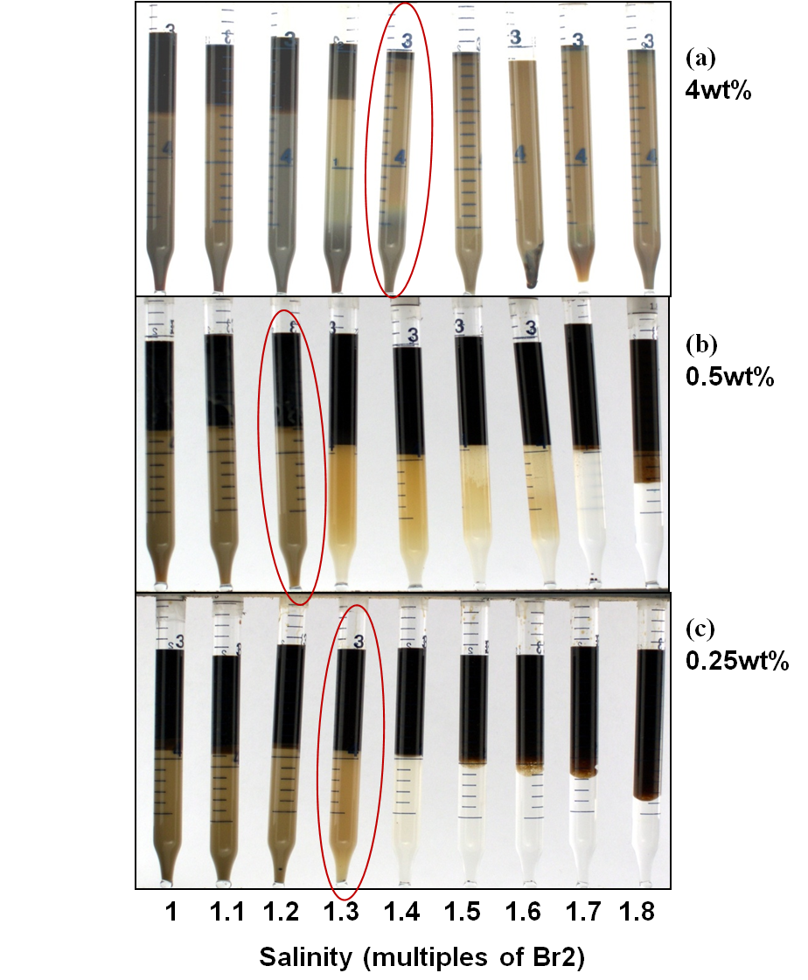
Surfactant selection
Increase hydrophobe size
to decrease optimal salinity
→C₁₃ 13PO sulfate (TDS-13A)
  Optimal salinity close to desired
  salinity (1Br2)
  σ_{o}~8 @ 1Br2
Literature on Alkyl Propoxy Sulfates
  Aoudia et al., 1995
  Wu et al., 2005
  Levitt et al., 2009
  Barnes et al. 2010
Notes:
The next logical thing to do was to increase the hydrophobe size of the sulfate to make it more lipophilic and hence reduce the optimal salinity.
But by doing this some of the potential issues that we were anticipating to run into were reduced solubility of the surfactant in brine.
We tried a c13 – 13po sulfate. And found that it had optimal salinity of about 1-2 - 1.4Br2 which is close to the reservoir salinity.
In the figure you have salinity on the x-axis, and surfactant concentration on the yaxis
At reservoir salinity the oil solubilization paramter was found to be ~8.
Alkyl propoxy sulfates have previously been reported in literature, but many of the studies except for one were at higher temperatures

Slide 10
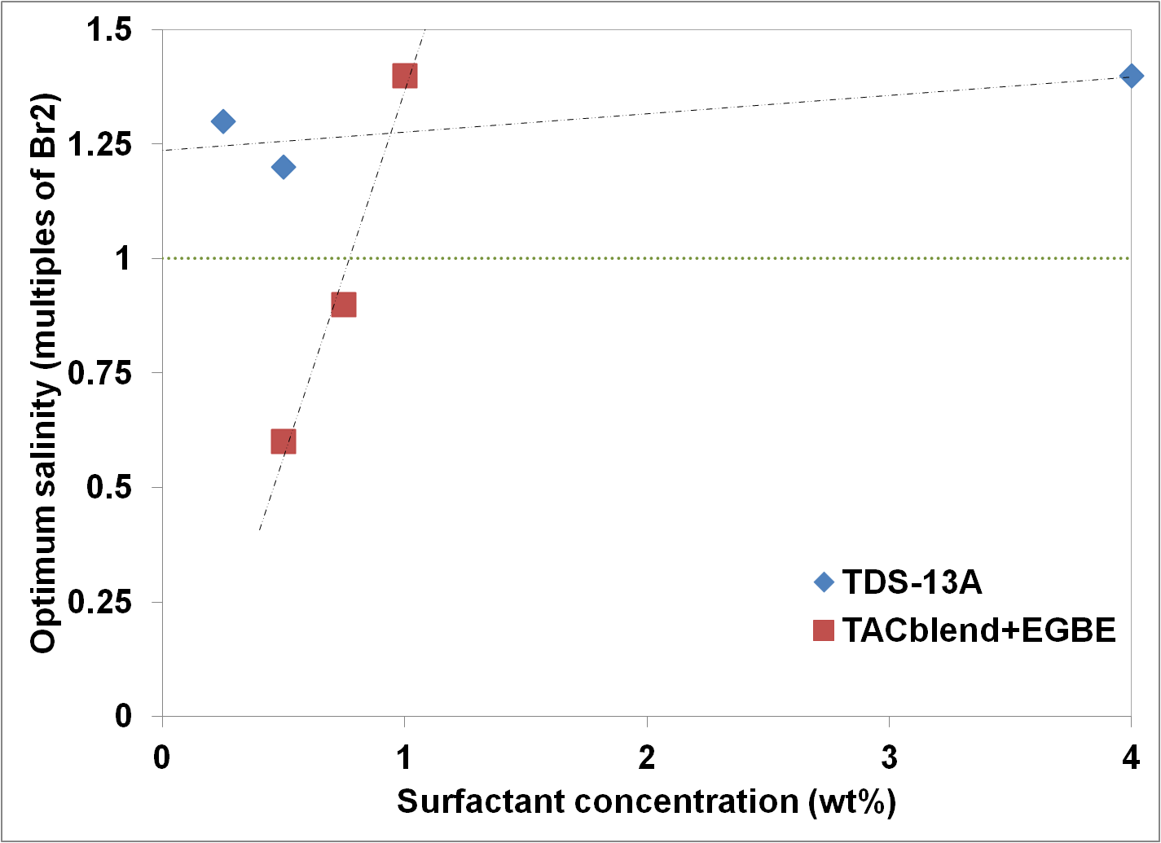
Surfactant selection
Alternative: TAC blend (TDS-13A/A6/C8 60:10:30) + EGBE
  TAC blend : EGBE = 4:1
  A6: C₁₆₋₁₈ branched alkyl xylene sulfonate
  C8: C₈₋₁₀ branched alkyl benzene sulfonate
Type II upon dilution
  undesirable
Reservoir salinity
Notes:
An alternate blend that was being considered was being considered was a blend of the C13 alkyl po sulfate with alkyl benzene and alkyl xylene sulfonates with EBE as co-solvent. Surf to egbe ratio was 4:1 wt%
While this blend at 1wt% surf conc had optimal salinity of about 1.4Br2 similar to the the c13 po sulfate, we found that upon dilution the optimal salinity reduced.
This is undesirable because when the optimal salinity falls below 1Br2 the reservoir salinity, t surfactant formulation become overoptimum is it will form a Type 2 microemulsion, where the surfactant will partition into the oil phase. This will cause retardation of the surfactant front.

Slide 11
Oil recovery efficiency: Imbibition
Notes:
- In this section I will discuss imbibition experiments that were carried out to measure the oil recovery efficiency of the surfactants.

Slide 12
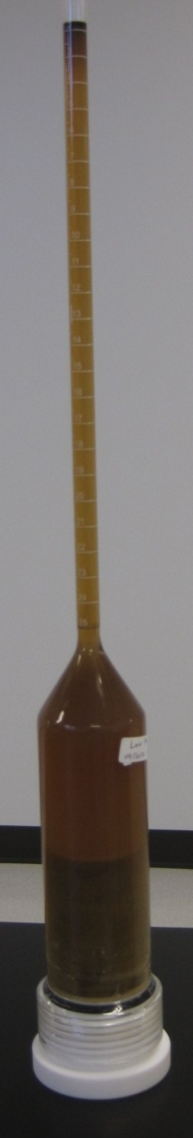
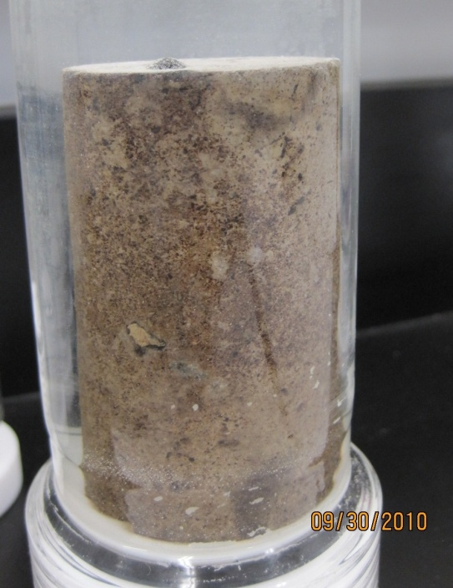
Procedure
Cores cleaned - Dean-stark extraction
Brine saturation under vacuum
Flood with crude to residual brine saturation
Age @ 90°C for 1 week
Place in imbibition cell with brine for
at least 20days.
Replace brine with surfactant solution.
Measure oil recovered
(not including oil there in the microemulsion )

Slide 13
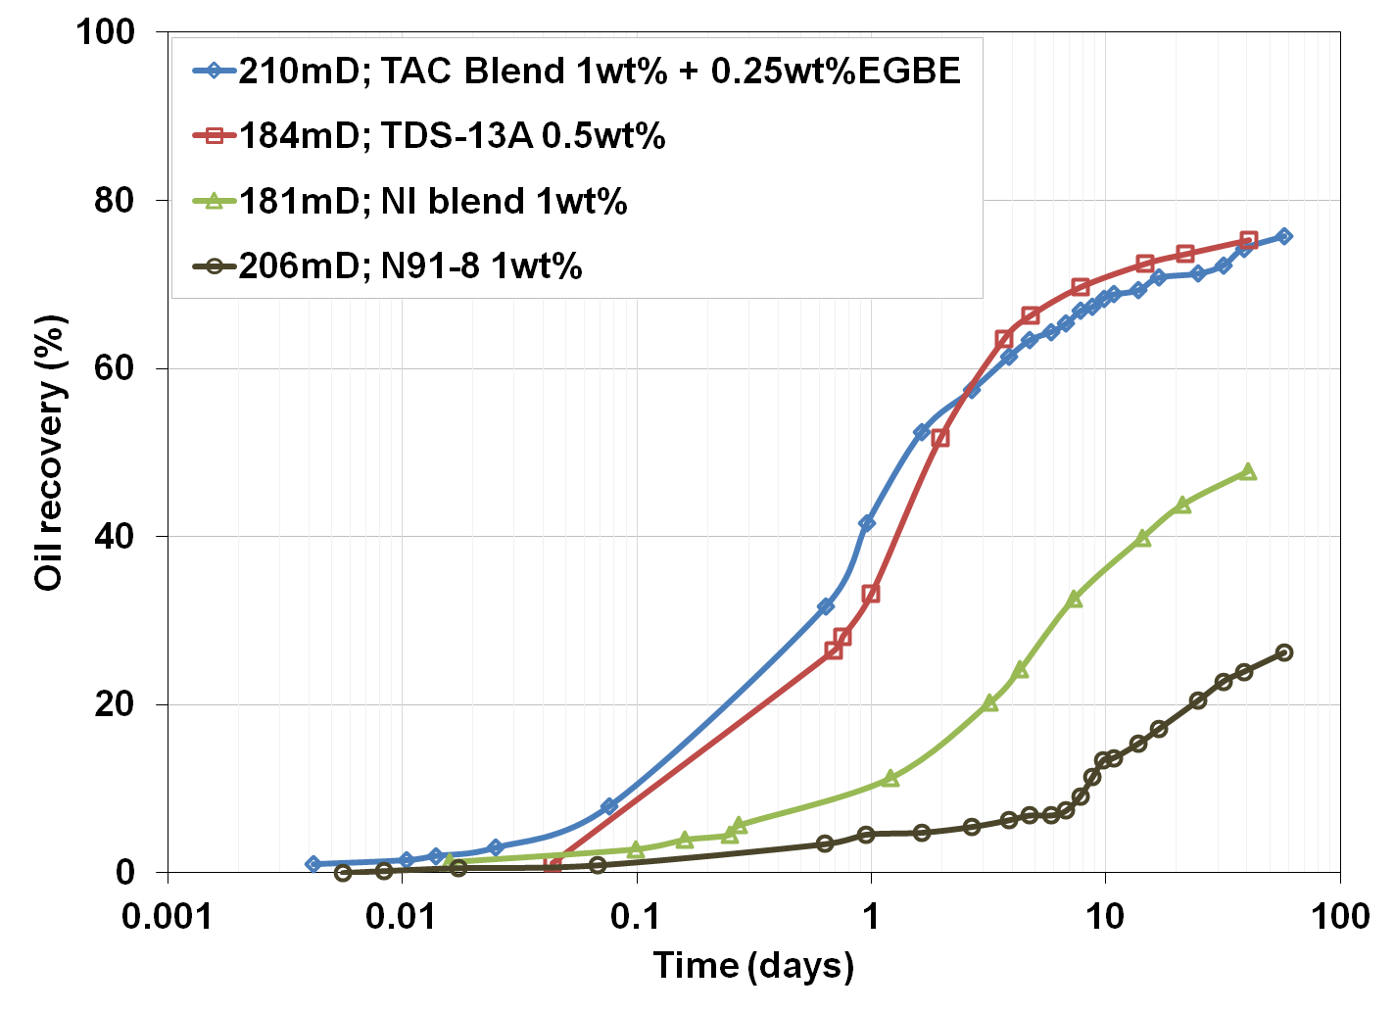
Recovery efficiency @ 1Br2
Dolomite outcrop cores
  3in length
  1.5in dia
Notes:
This graph shows the oil recovery history of different surfactants at reservoir salinity at 25C in 3inch long 1.5inch dia dolomite outcrop cores with permeabilities of 180 – 200mD
The red line corresponds to 0.5wt% TDS-13A, and the blue line to 1wt% TAC blend with EGBE. Both of these if you recollect had optimal salinity close to reservoir salinity and the TDS-13A had a solubilization parameter of ~ 8 at reservoir salinity.
Both of these recovered about 75% of the oil.
Compare these to recovery the ni blend and n91 – 8 (c 9-11 8e0 alcohol) both of which are poor.
This is because the optimal salinities which are not close to the reservoir salinity.

Slide 14
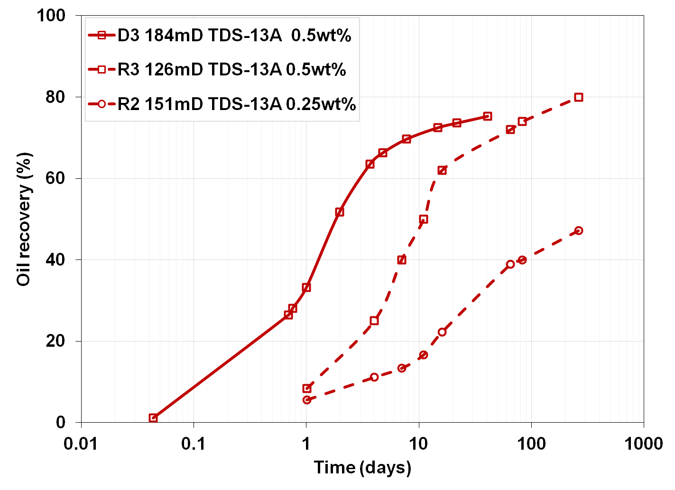
Recovery efficiency effect of concentration
Reservoir cores
  1in length
  1in dia
Notes:
This graph shows the imbibition history for tds-13a.
The solid line is for dolomtie outcrop core, and the dashed line is for reservour core.
For the same concentration 0.5wt% the final oil recovery in dolomite outcrop and reservoir cores are the same, although the one in the reservoir core seems to be slower.
When the concentration of the surfactant is decreased to 0.25% the oil recovery reduces dramatically probably because the OFT was higher at the lower surfactant concentration

Slide 15
Adsorption experiments

Slide 16
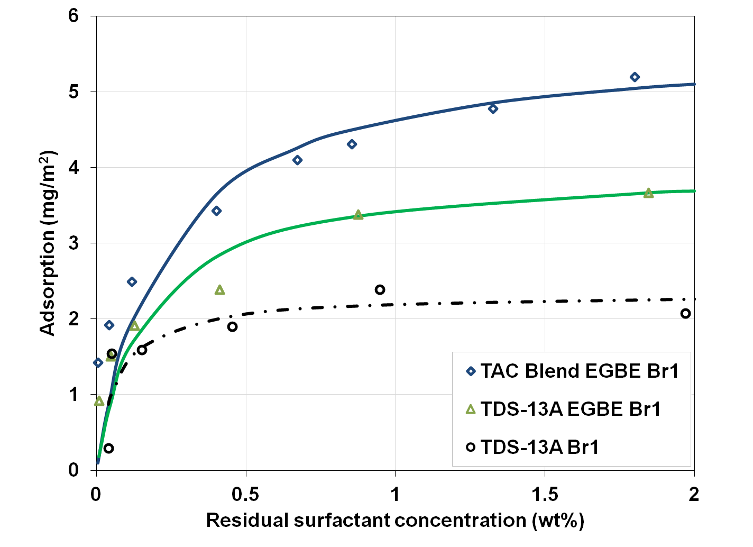
Static adsorption on dolomite powder
24 hr mixing
S.A of reservoir rock 0.16 m²/g
Notes:
-

Slide 17
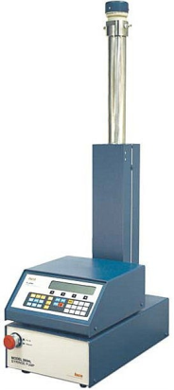
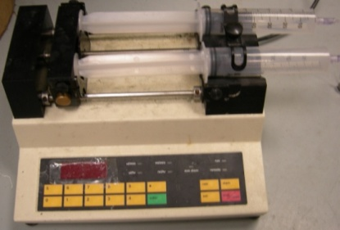
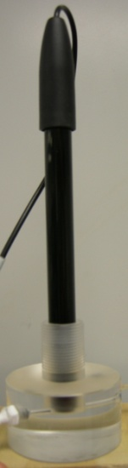

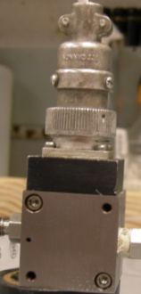
Dynamic adsorption: setup
Syringe pump/ ISCO pump
Core holder/ Sand pack
Bromide electrode
Bromide concentration reading
Pressure monitoring
Pressure transducer
Sample collection

Slide 18
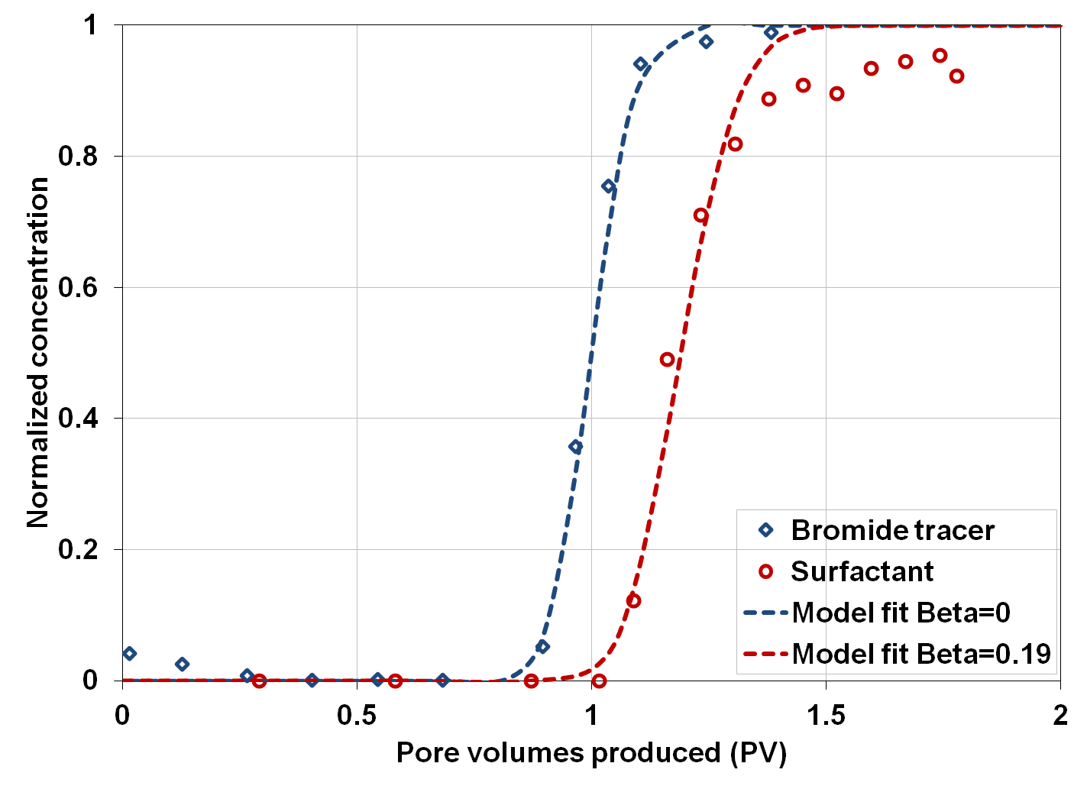
Dynamic adsorption: sandpack
Dolomite pwd.
102 Darcy
6hr residence time
Eq. adsorption on reservoir rock ~ 0.127 mg/g rock.

Slide 19
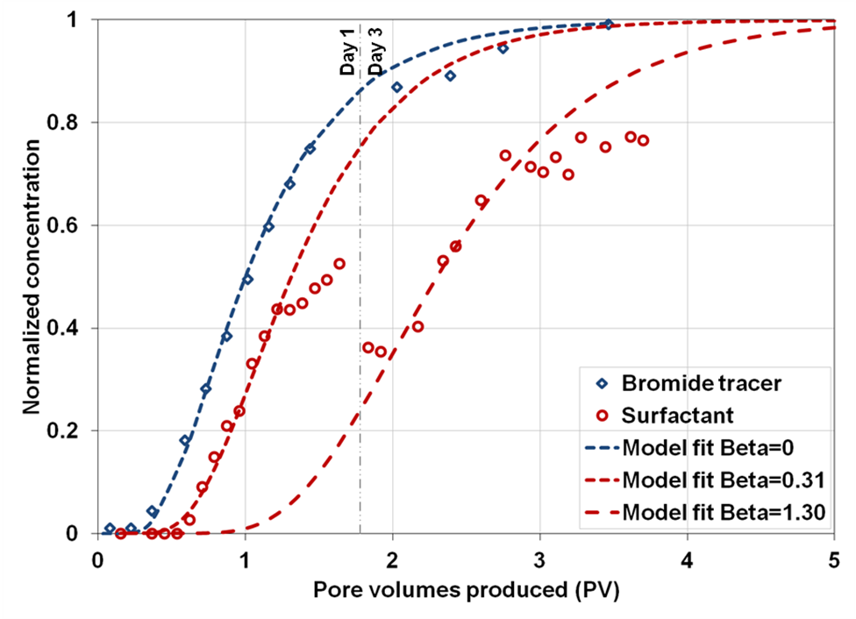
Dynamic adsorption: reservoir core
6mD
6hr residence time
Eq. adsorption on reservoir rock (mg/g rock)
  ~ 0.063
  ~0.263

Slide 20
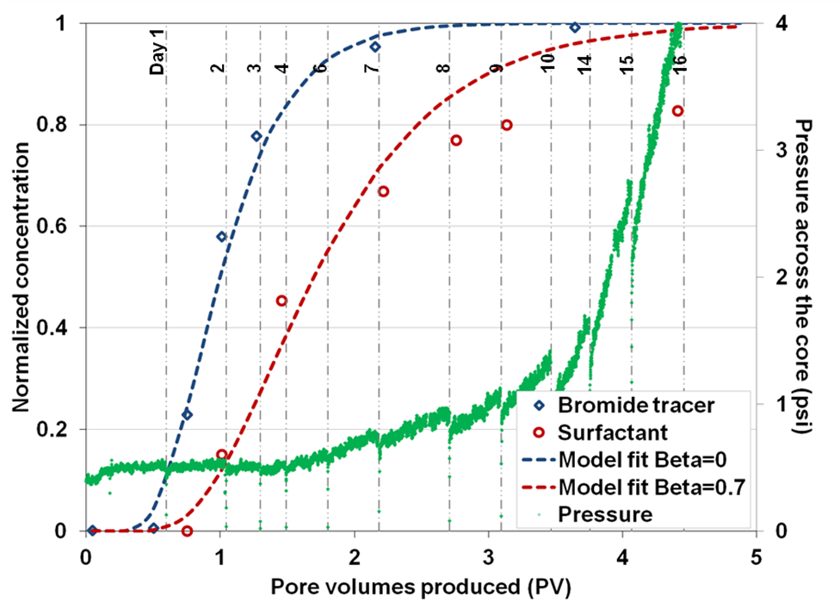
Dynamic adsorption: reservoir core
15mD
2μm filter
30hr residence time
Eq. adsorption on reservoir rock
~0.26 mg/g tock

Slide 21
Effect of solution gas

Slide 22
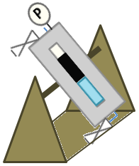
Procedure
Purge cell of air
Make live oil
Inject surf. solution
Gas
P
Gas
P
P
Oil
Surf.
soln.
Observe phases
Hand mix sample
Inc. temp. to 30°C
P
P

Slide 23
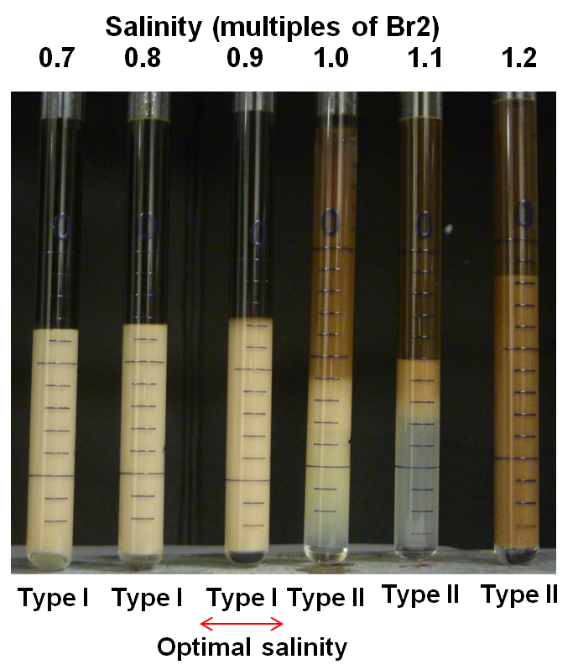
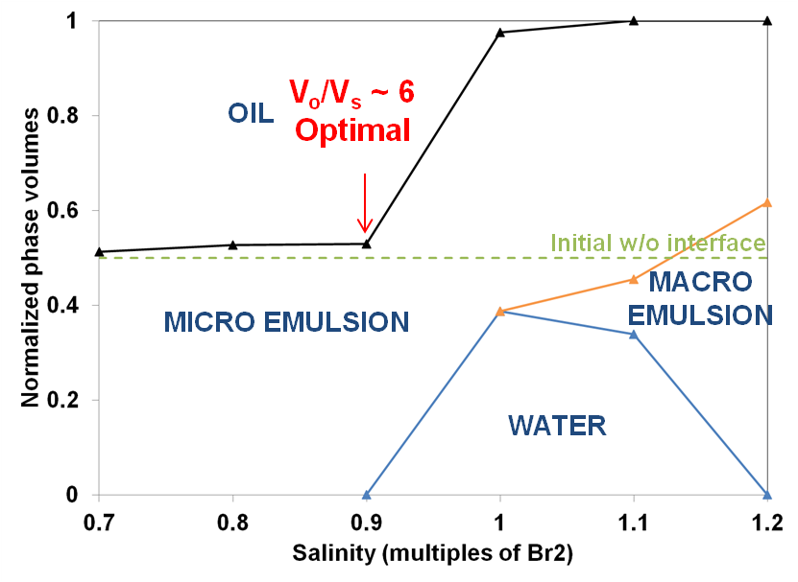
Dead oil @ 30°C: TDS-13A/S3 90/10
1wt% TDS-13A/S3 90/10

Slide 24
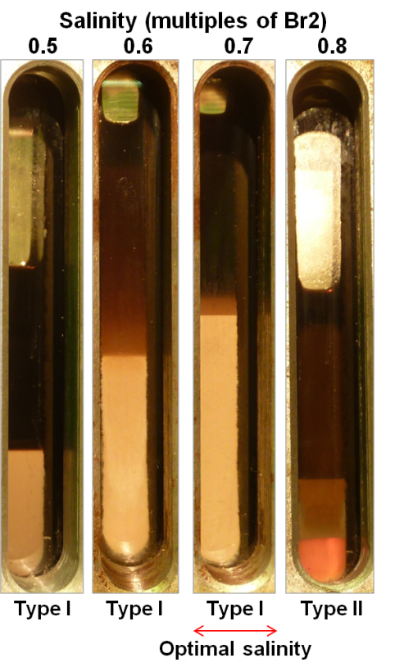
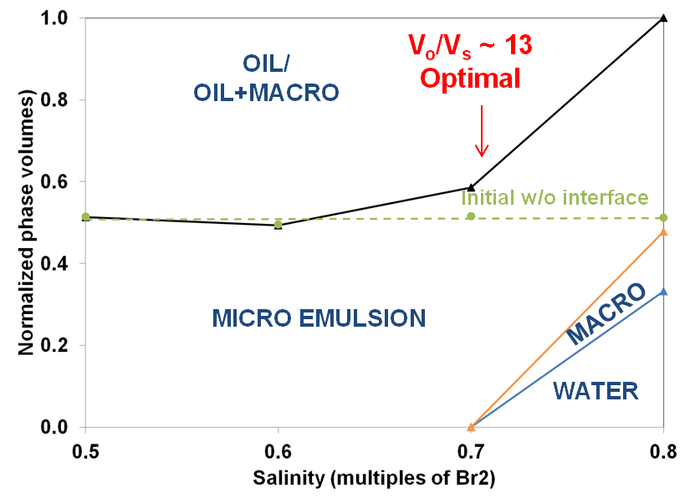
Live oil @ 30°C: Ethane 50psi
1wt% TDS-13A/S3 90/10

Slide 25
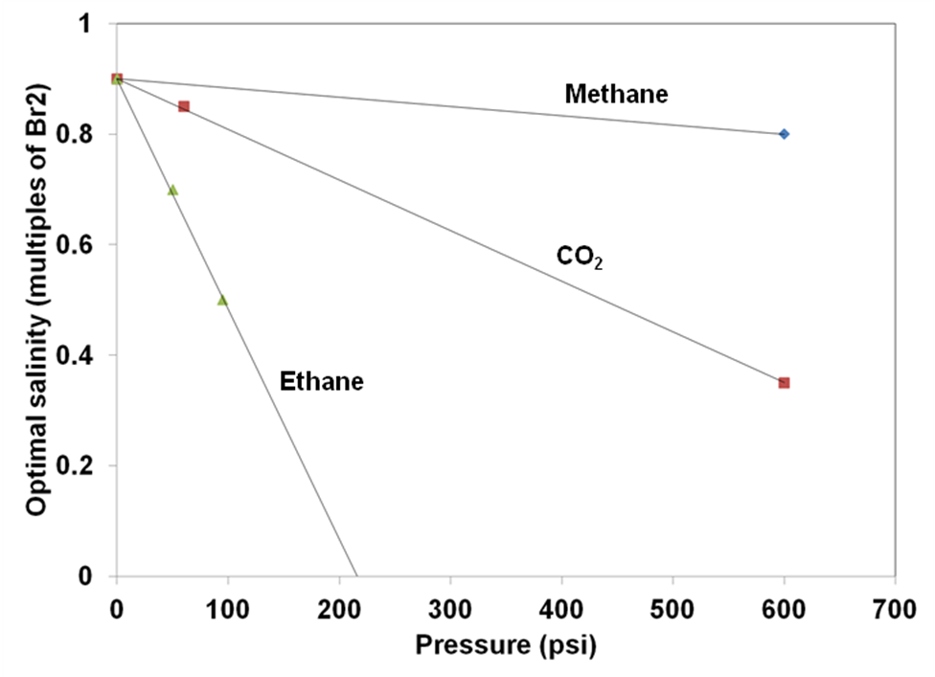
Live oil: comparison of gases
1wt% TDS-13A/S3 90/10
Change in optimal salinity
Methane
~ -2%/100psi
CO₂
~ -11%/100psi
Ethane
~ -46%/100psi

Slide 26
Conclusions

Slide 27
Part 1
TDS-13A: C₁₃13PO Sulfate
  Optimal salinity close to reservoir salinity (~11,000ppm TDS) @ @ 25°C
  Oil solubilization parameter ~8 @ reservoir salinity
  Good oil recovery in imbibition ~75% for 0.5wt%
TAC blend (TDS-13A/A6/C8 60:10:30) + EGBE (4:1)
  A6: C₁₆₋₁₈ branched alkyl xylene sulfonate
  C8: C₈₋₁₀ branched alkyl benzene sulfonate
  @ 1wt% TAC blend – oil recovery in imbibition good ~70%
  Phase behavior Type II with dilution
  Eq. adsorption ~ 0.8mg/g rock

Slide 28
Part 2
Adsorption of TDS-13A
  Static (~0.34mg/g) and dynamic (~0.26mg/g) comparable.
  Dynamic adsorption
    Effluent concentration reached only ~80% injected
    Pressure across core increased
Effect of solution gas: decrease in optimal salinity
  Methane ~ 2%/100psi
  Ethane ~ 46%/100psi
  CO₂ ~ 11%/100psi

Slide 29
Slide 29
Acknowledgements / Thank You / Questions

Slide 30
Back up slide
Solubility of gases normalized by methane solubility
(mol frac/mol frac)
 | CO2 | Ethane
N-alkanes | 3.2 | 6
N-alkyl benzenes | 4.4 | 7.9

